Slide 1
IMPACT OF CAR FEATURES
PROJECT DESCRIPTION: The Project “Analyzing the Impact of Car Features on Price and Profitability” focuses on growing trends in manufacturing cars and their fuel type in recent years.
My role as a Data Analyst is to optimize the pricing and product development decisions to maximize profitability. This could help the manufacturers on what factors to focus on and also help in meeting the consumer demand.
APPROACH: The Approach for this project is simple, as it is an end-to-end project we are required to understand the case scenario of the project make our queries, and decide on what columns will meet the better understanding of any respective scenario.
Also, It is essential to gain some domain knowledge. So firstly I will research this domain and then study the data set provided and then start doing the spreadsheet. Then break down the project into bits and solve them separately to avoid confusion.
TECK-STAC USED: The Tech stack used in this project is Microsoft Excel 2021 Version. We can also use Python for data analysis but in Excel the market segmentation is easily performed and can be easily understood.

Slide 2
INSIGHTS: There are many insights drawn from this project. But I would like to mention three insights that
Standout among all they are,
(i) The maker of the car, “Maybach” has the highest average of the Manufacturer’s Suggested Retailed Price(MSRP). But surprisingly the Average popularity of the company is very low i.e. just 67 where the highest popularity is 3916 for “Audi” but again the MSRP is low i.e. just 61,457 dollars.
(ii) While looking at the pivot table where every car maker’s popularity, MSRO, and Engine HP are compared unlike the above insight, “Ford” has the highest Popularity with the sum of 49,83,817, and as expected the MSRP is low and engine HP is decent. That means popularity and MRSP are directly proportional to each other.
(iii) The Correlation between ‘MSRP’ and ‘Engine HP’, and ‘Engine Cylinders’ is positive, and ‘Highway MPG’, and ‘City MPG’ is a negative correlation.
I will mention every insight drawn, the imagination, and the improvement in “Analysis and visualization” i.e. in the fourth slide.
RESULT: This Project helped me understand the car manufacturing domain and also how to handle the data if there are no queries given and need to do it on my own.
When it comes to tech stack, it’s always a learning process as we get to learn new concepts in every project. So in this project, I got to understand the “Regression Analysis” and “Market segmentation” in Excel. Which was challenging but helped to understand the patterns and trends in this project.

Slide 3
LINK TO EXCEL SHEET (ctrl + tap)

Slide 4
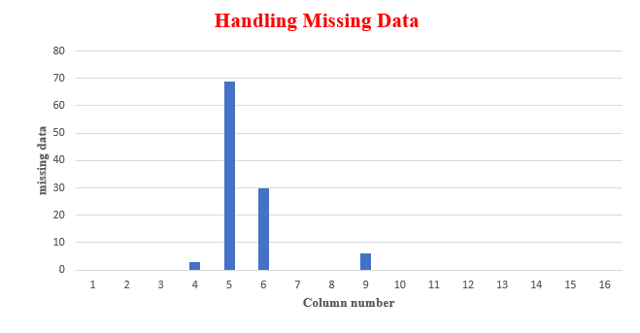
ANALYSIS AND VISUALIZATION
1) Handling Missing Data:
The number of missing values in each column is mentioned below the photo and the Visualization
of the missing data in the bar graph, where the ‘column number’ is on the X-axis and missing data is on the Y-axis.
It is essential to handle the missing data before performing
any other task because the data should not contain any missing values.
If there are missing values then the performance of the Excel tasks gets
disturbed.
Then Imputation is performed. The numeric missing values are replaced with the mean values of the remaining data and categorical data
is replaced with ‘N/A’.
Now the data is ready to perform the analysis.

Slide 5
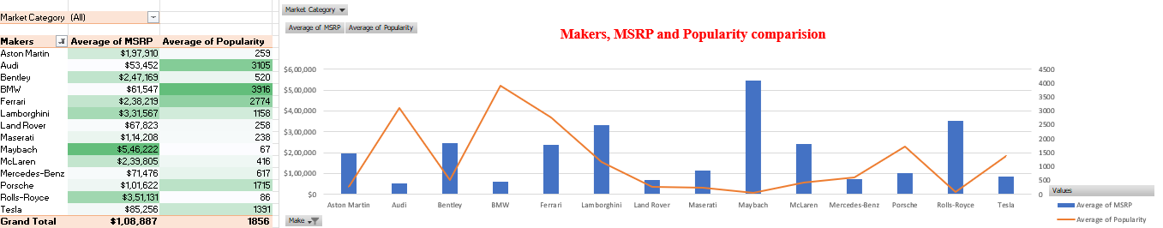
2) Analyzing the relationship between a car's features, market category, and pricing:
I considered the car features as ‘popularity’, and the Market category as ‘Makers’. From the above pivot table, I took
the makers in the first row, the Average of MSRP, and Popularity in values alongside the Market category in the filters. Also applies
conditional formatting to the above pivot table to find the relation between them.
The graph clearly states that the ‘MSRP’ and ‘Popularity’ are inversely proportional to each other. That means the MSRP
of ‘Maybach’ is 50k USD but the popularity is just 67 which is the least among the data. BMW has the highest popularity of 3916
as the MSRP is the lowest after Audi.
The best Maker from the above data is “Audi” since it has the lowest MSRP and managed to get the second highest popularity of 3105. “Ferrari” is not as affordable as others but its popularity is far better than the others, which is an exception in inverse proportion between MSRP and Popularity.

Slide 6
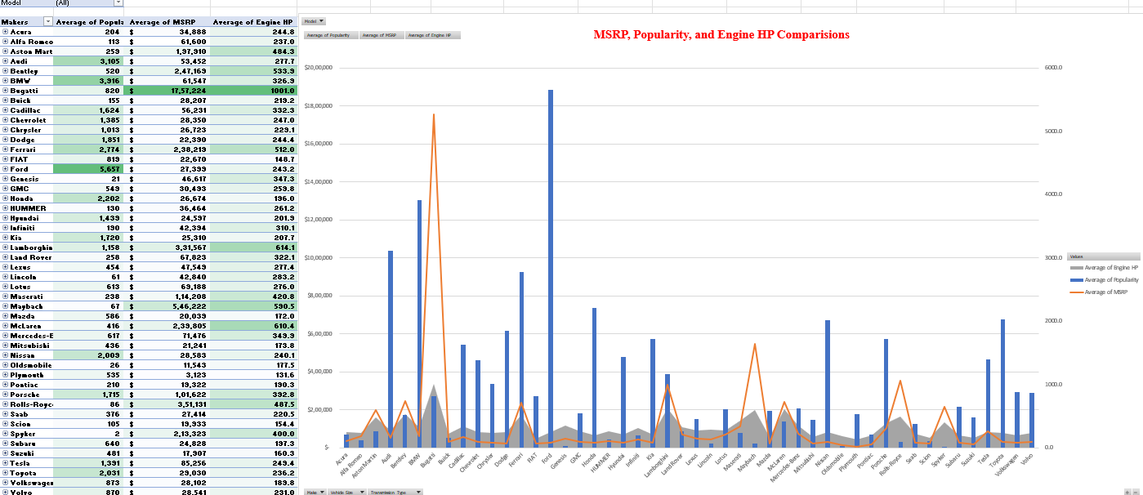

Slide 7
From the above slide, I tried to find the relationship between the car’s features (Engine HP), Popularity, and MSRP.
Similarly, applied the pivot table and comb graph as the visualization of the pivot table. I applied other features like
‘Transmission type’, ‘vehicle size’, and ‘Make’ are in the filters.
From the graphs the insights drawn are,
(i) Engine HP and MSRP are directly proportional to each other. It is clearly
Understood that if the pricing of the car is high then the Engine HP is high.
(ii) Similarly, the Popularity and Engine HP are inversely proportional as people
to buy affordable cars, but the manufacturers couldn’t provide the cars with greater Engine horsepower.
(iii) So it’s essential for the manufacturer to decide on whether to sell a few
Products for a higher price or more products with the base price. I would suggest manufacturing the cars with less Engine HP so
the price automatically drops down and the sales increase.
(iv) When comes to the size of the vehicle, the manufacturer offers three types of
vehicle sizes, ‘compact’, ‘large’, and ‘midsize’. Most people tend to buy cars of “compact” size, so I would suggest the makers
manufacture more cars of compact size to get more profits.
(v) There is no huge difference between the transmission types of the cars i.e.
‘manual’, ‘automatic’, ‘direct driven’, and ‘automated manual’ but mostly the popularity is high for “Manual cars” and then comes
The “Automatic cars”.
(vi) From all the above relationships and insights I came to one conclusion that
if the manufacturer can provide the features of the car for better pricing then people tend to buy them and manufacturers can get
higher profits.

Slide 8
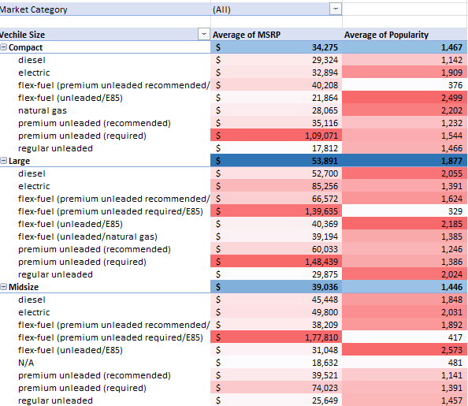
3) Market Segmentation for pricing strategy:
I considered Vehicle size and engine fuel type as the car’s features to find the pricing strategy using the market segmentation technique. The vehicle size, “Large” has the highest MSRP of $53,891 and also the highest popularity of 1,877.
When the Engine fuel type is applied to the vehicle size, “regular unleaded” has the highest popularity with the lowest MSRP. So it’s okay to increase the price a bit as it has demand in the market. Meanwhile, “premium unleaded(required) has the highest MSRP of $150k but yet has good popularity in the market. It would be wise if you decrease the price in this category to get more profits.
There is no huge difference in both the MSRP and popularity between “compact” and “Midsize” vehicles. But in compact the fuel type, “electric”, “flex-fuel(unleaded/E85)”, and “natural gas” has the highest popularity but the flex-fuel has less MSRP compared to the other two.
Premium unleaded (required) has the highest MSRP and popularity higher than the average popularity. So decreasing the pricing of that car would increase the pricing.

Slide 9
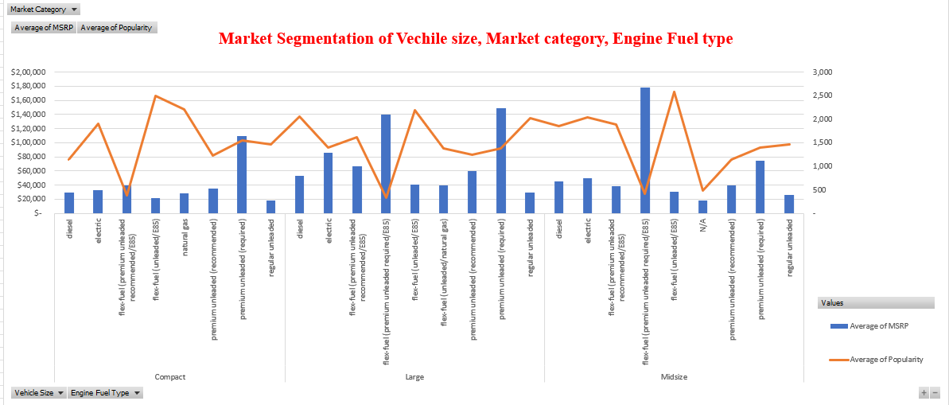
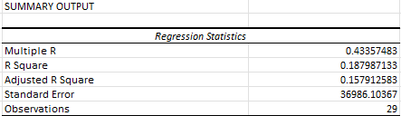
The graph depicts the visualization of the last slide pivot table. The Average pricing is mentioned in the secondary axis and MSRP in the primary axis in the form of a bar graph.
The graph is then segmented into respective vehicle sizes in the X-axis and then the Engine fuel type as a sub-segmentation.
In compact size, the popularity of electric vehicles is comparatively higher than the electric vehicles of large and midsize so increasing the manufacturing of that particular featured car could be profitable.
The R-squared value of 0.18 suggests that vehicle size, and engine fuel type explain about 18% of the variability in the popularity of the car. This means that the model may not be capturing a significant portion of the variation in popularity, indicating that there may be other factors not accounted for in the model.
The adjusted R-squared value of 0.15 is lower than the R-squared value, which means that the model might be slightly overfit. This indicates that the model may be too complex or some independent variables(vehicle size and engine fuel type) may not be relevant.

Slide 10
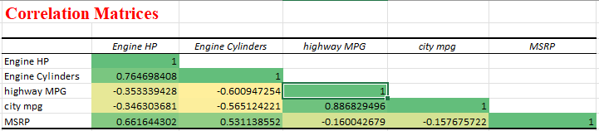
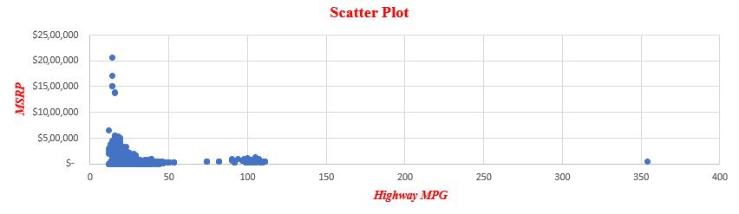
4) Identifying profitable features:
This part of the project is to identify the profitable features
of the car. I took Engine HP, Engine Cylinders, Highway MPG, and City MPG as the car features. Now to know which features are profitable I applied the regression analysis technique to the selected data.
Firstly, I took the correlation matrices of all four features along with the MSRP and then applied conditional formatting so it is visually clear to understand the relation between them. The correlation between MSRP and Engine HP, Engine cylinders is positive i.e. 0.66 and 0.53 indicating that if the MSRP increases then accordingly the HP and number of cylinders increase as well. The correlation between MSRP, highway mpg, and city mpg is negative and very low too. This means that as MSRP tends to increase, highway MPG tends to decrease and vice versa.
The above scatter plot shows the relationship between MRSP and Highway MPG. There are also other scatter plots of the features but would like to clearly explain whether Highway MPG is a profitable feature or not so that it can imply other features as well. As you can see from the graph, most of the cars with Highway MPG vary between 0 to 50 and then around 100, and mostly the pricing for all the cars is below $5,00,000. MPG stands for ‘Miles Per Gallon’ so Highway MPG means the mileage of the car per mile while driving on the highways. From the correlation, we can say that if the highway MPG is high then the average MSRP will be low which means more people will tend to buy that car so the sales will go up and so are the profits. However we can never get to a conclusion about the profits by only considering highway MPG, there might be other factors as well.

Slide 11
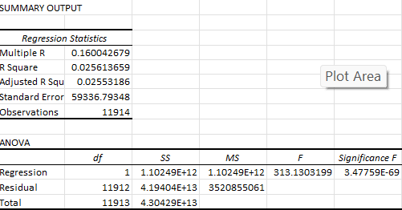
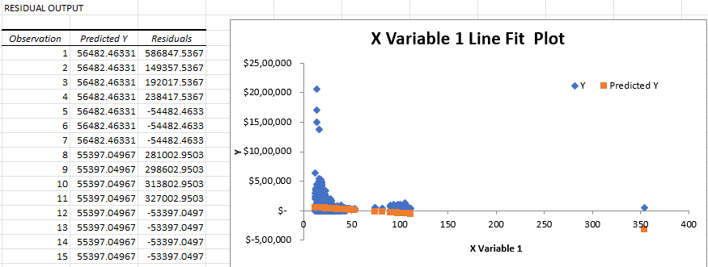
Here I performed a statistical technique called ‘regression analysis’ to identify and quantify the relationship between dependent and one or more independent variables. Here dependent variable is MSRP and the independent variable is Highway MPG. From the regression analysis table, we got the R-squared value of 0.0025 which means that Highway MPG can explain only about 2.5% of the MRSP variance.
The standard error of 59336 indicates the average amount by which the observed values deviate from the predictive values as shown in the below X Variable 1 Line Fit Plot. ‘blue’ dots represent the MSRP of the car and the ‘Orange’ dot represents the predicted MSRP values. So by all the analysis, I conclude that Highway MPG could be a profitable feature if the mileage is increased but only that factor can’t decide the profit of the product as there is weak correlation matrices.
The best correlation with MSRP among the car features is Engine HP with 0.66 and the regression model appears to have a reasonably good fit to the data, with Engine HP being a strong predictor of MSRP. So this could be possibly a profitable feature for the manufacturers. This data is shown in the EXCEL sheet attached on the 3rd slide of the presentation.

Slide 12
Thank you!!

